Slide 1
Interface Design & Related Concepts
Xiaohan Feng
Notes:
Today, I will introduce the Interface Design and Related Concepts.
And I hope it is helpful for your assignment.

Slide 2
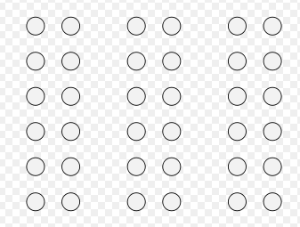
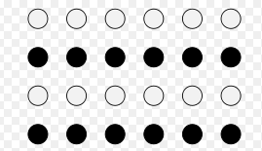
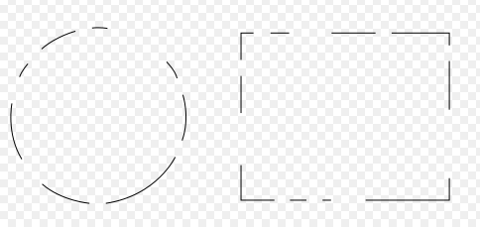
Six Principles of Grouping(Gestalt laws of grouping)
The principles of grouping are a set of principles in psychology to account for the observation that humans naturally perceive objects as organized patterns and objects.
Proximity
objects or shapes that are close to one another appear to form groups
Similarity
allow people to distinguish between adjacent and overlapping objects based on their visual texture and resemblance
Closure
our mind trend to see complete figures or forms even if a picture is incomplete, partially hidden by other objects
Notes:
Ok, so let’s start with the Six Principles of Grouping.(六种成组原则)
The principles of grouping are a set of principles in psychology to account for the observation that humans naturally perceive(认知) objects as organized patterns and objects
1.The first principle is Proximity(邻近). It mainly means objects or shapes that are close to one another appear to form groups. In this example, the closed two points are most likely to be seen as a group.
2.The second principle is Similarity. It allows people to distinguish between adjacent and overlapping objects based on their visual texture and resemblance. For example, in this case, we can distinguish the white point and black point as two groups, although they are adjacent points.
3.The third principle is “Closure”, it tells us our mind …..
So in this example, we will see the circle as one group, not many groups, the same as the rectangle.
https://en.wikipedia.org/wiki/Principles_of_grouping

Slide 3



Six Principles of Grouping(Gestalt laws of grouping)
Good Continuation
When there is an intersection between two or more objects, people tend to perceive each object as a single uninterrupted object
Common Fate
When visual elements are seen moving in the same
direction at the same rate (optical flow), perception associates
the movement as part of the same stimulus
Good Form
refer to the tendency to group together forms of similar shape, pattern（i.e. symmetry）, color, etc.
Notes:
4.The fourth principle is the Good Continuation. It tells us xxxx
In this example, we will see this picture as two keys not one key. That’s the meaning of this principle.
5.The next principle is the Common Fate, it tells us xxx
For example, when we see many birds fly in the sky with the same velocity in the same direction, we will see them as one group.
6.The final principle is the Good Form. It refers to the tendency to xxxx.
For example, you will see the Olympic rings as one group not five, because of their similar shape.
So actually, human always use these six principles to organize the object they see in group to help them engages the world.

Slide 4
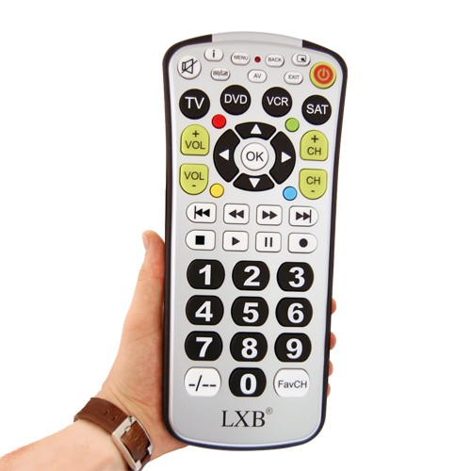
Question 1
Which principles are being used to help the user more quickly perceive related functions of buttons
Good Form
Closure
Proximity
Similarity
Notes:
And actually, the designer also use these principles in their design. Now let’s see this question.
Discuss/Think xxxxx, I will give you one minute to think about it.
So here’s the answer, for the volumn and channel button, the “Good Form” principle is used, you can see the same shape is used here, just like the Olympic ring.
For the “up down left right” button, the “Closure” principle is used, you can see although it is not a completely circle,
We can also see it as a group.
For the “play, quick play, stop ….”button, the “Proximity” Principle is used, you can see the closed two buttons are seen as a same group.
For the “number” botton, the “Similarity” Principle is used, you can see it is very easy to distinguish them based on their visual texture from other part.
The buttons (Go, Reset, etc.) are shown in different colors (i.e., not consistent);
The buttons are not aligned;
The functionalities of the buttons are not clear (e.g., what does ‘Go’ mean?);
The button ‘Press here to continue to the next form’ is very wordy and inconsistent with other buttons in terms of style and font;
The caption/title of this form is not meaningful (what is ‘FORM FILL-IN’?);
The font of labels are not consistent;
The abbreviation ‘ADDR’ is not explained (same as ‘Address’?)
Format of the input (order of last/first name, format of address, date, etc.) so they are error-prone;
For ‘Doctor name’, a text input box is not efficient as a list from which a user can select a doctor;
Or, any other remaining problem that is not listed above.

Slide 5
Question 2
Which of the buttons is designed to catch the user’s attention, why?
On/Off button
the most important function for users, all of the functions are based on this.
the only button to prove that the remote control is working (when TV is off)
Notes:
OK, Let’s see another question. Give you 1 minutes to think about it.
The solution is “on/off” button. Because it is the most important function of ….
So now you know, if you were a designer, you should also think about the six principles of grouping and think about what needs to be designed to catch the user’s attention.
The buttons (Go, Reset, etc.) are shown in different colors (i.e., not consistent);
The buttons are not aligned;
The functionalities of the buttons are not clear (e.g., what does ‘Go’ mean?);
The button ‘Press here to continue to the next form’ is very wordy and inconsistent with other buttons in terms of style and font;
The caption/title of this form is not meaningful (what is ‘FORM FILL-IN’?);
The font of labels are not consistent;
The abbreviation ‘ADDR’ is not explained (same as ‘Address’?)
Format of the input (order of last/first name, format of address, date, etc.) so they are error-prone;
For ‘Doctor name’, a text input box is not efficient as a list from which a user can select a doctor;
Or, any other remaining problem that is not listed above.

Slide 6



Iconic communication
Iconic communication
Refer to communication by visual imagery
Include drawings, visual signs, objects
Universal Icons: Stop, Play, Pause, Record
Notes:
OK, here’s another concept I want to mention. -----The Iconic communication.
The Iconic communication refer to ……
And also, you can see, in the remote control, there are some buttons like these, although they are just some shape, we all know what they really means, they are called Universal Icons.
Actually, the aim I introduce this concept is to remind you that you can also use the iconic communication in your own interface design…Just a reminder.
https://www.youtube.com/watch?v=2gPo5GQYac4

Slide 7
Types of reasoning
Deductive
Reasoning by logic, e.g. modus ponens
Inductive
Generalize attributes from singleton observation
Abductive
Reverse logic: given effect, conclude cause
Analogical
Generalize relations from pairwise observations
Notes:
OK…now let’s go to another concept. The types of reasoning.
The reason why I introduce these four types of reasoning is that…actually, when the user use your interface, they are actually learning to use it, so you need to know how do they do the reasoning, how do they engages new things, then you may design a better interface for user to use.
OK, so actually, there are four types of reasoning.
Deductive, inductive, Abductive, Analogical
1.The Deductive(推断的) is actually the reasoning by logic, for example, modus ponens(演绎推理)
2.The Inductive(归纳的) is that generalizing attributes from singleton(一个) observation
3.The Abductive(反绎推理) is actually the reverse logic, which means I give you the effect, and you conclude the cause.
4.The Analogical(类推的) is that generalizing relations from pairwise observations.

Slide 8
Examples
Based on the floor is wet, I conclude that today is rainy.
Abductive(given effect, conclude cause)
learn that part of the resistor color code includes red=2, orange=3, yellow=4, green=5, blue=6. I conclude that violet=7
Inductive(Generalize attributes from singleton observation)
Today is like a day in paradise. We don’t need an umbrella.
Analogical(Generalize relations from pairwise observations)
The rule says SEEM3510 lectures can only be attended by SEEM students. I conclude that everyone I see in a SEEM3510 lecture must be a SEEM student
Deductive(Reasoning by logic)
Notes:
I know they are so abstract, so I put some examples here. Let’s see them one by one.
1.The first one, “Based on the floor is wet, I conclude that today is rainy”. so which type of reasoning it is ?
Ok, let’s see the answer, it is abductive…because you can see, the effect is given(the floor is wet), and I conclude the cause(today is rainy)
2.The second one, “learn that ….”,which type of reasoning it is ?
The answer is inductive. Because you can see, I generalize attributes(Violet=7) from this observation (red=2, orange=3…..).
3.The third one, “Today is xxxx”, what type is it ?
The answer is Analogical. You can see, I generalize relations from pairwise observations(day in earth and day in paradise),since we don’t need an umbrella in paradise, we don’t need an umbrella today.
4.The final one, “The rule says …..” what type is it?
The type is deductive. As you can see, it is a reasoning by logic, it is intuitive.
OK, that’s all the examples of type of reasoning.
Again, the reason why I introduce these four types of reasoning is that I want you know how do your users engage new things, then you may design a better interface for new user to learn to use.

Slide 9
Different forms of long-term memory
Declarative Memory
Remembering “what”
Procedural Memory
Remembering “how”
Declarative Memory
Episodic Memory
events
Semantic Memory
facts
Notes:
OK, now let’s go to the final concept.----Different forms of long-term memory
The reason why I introduce the concept of Different forms of long-term memory is that….as you know, the users are actually learning to use your interface. So you need to know how they memory the things in order to design a more memorable interface and let your user remember how to use your interface, it good to keep your users as a long term user.
In general, there are two types of long-term memory, Declarative memory(陈述) and Procedural Memory(程序).
The declarative Memory remembering “what”, and Procedural Memory remembering ”how”.
And the Declarative Memory also could be divided into to two kinds of memories. One is Episodic Memory(插话式记忆), it mainly refers to remember the events. Another one is Semantic Memory(语义式记忆), it mainly refers to remember the facts.

Slide 10
Examples
The names of your friends
Semantic Memory, subtype of declarative memory(facts)
The ability to juggle balls
Procedural Memory(how)
Events of the first day you started studying in CUHK
Episodic Memory, subtype of declarative memory(event)
Notes:
Also, I will give you some concrete examples.
The first one is “The names of your friends.” It is Semantic Memory,xxxxx
The second one is “xxxxx” It is xxxx
The last one is “xxxxx” It is xxxxx
Ok, ummm, The reason why I introduce the concept of Different forms of long-term memory is that….as you know, the users are actually learning to use your interface. So you need to know how they memory the things in order to design a more memorable interface and let your user remember how to use your interface.

Slide 11
Extensions
The history of the graphic user interface
https://www.youtube.com/watch?v=U1Oy4X5Ni8Y
Notes:
Ok, here we almost finish our today’s tutorial, I also prepared two videos to share with you, each of them is about 11 minutes, so because of the time …..

